Slide 1
DISEASE PREDICTION SYSTEM
By Elizabeth Ololade Ayedenu
Data science

Slide 2

HYIAGIEA DISEASE PREDICTION SYSTEM

Slide 3
INTRODUCTION
Disease a particular abnormal condition that negatively affects the structure or function of all or part of an organism and is not immediately due to any external injury.
Diseases are often known to be medical conditions that are associated with specific signs and symptoms. This has impede the lives of many round the world.
For centuries man has tried to reduce the causaulity of that which ravages his existence.

Slide 4
IMPLICATION
Therefore An early detection and symptoms may be the only way for men to have a short victory.
Hence the need for a system like "Hygieia” which help to give prediction of diseases when presented with a symptom from patients

Slide 5
Introducing Hygieia Healthcare system
Leveraging Advanced Technology for Early Detection
The Healthcare system receives patient symptoms in real-time.
Utilizes machine learning algorithms to analyze symptoms and predict diseases.
Enables early detection and proactive treatment planning.

Slide 6
AIMS
"Hygieia" aims to focus on few of the following diseases: 1. Diabetes 2. Hepatitis 3. Dengue 4. Pneumonia 5. Malaria 6. Covid_19
7. Ebola

Slide 7
Procedures
Collection/scraping of data
Creating a Health system database
Importing data into Mysql
Exporting into pandas for cleaning and exploratory analysis
Importing necessary model algorithms for training and testing data
Fitting data to model
Carrying out prediction

Slide 8
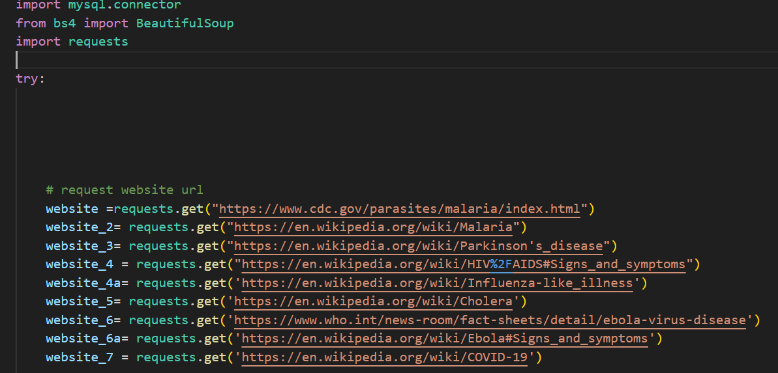
Collection of Data
Sample of the dataset collected from various websites

Slide 9
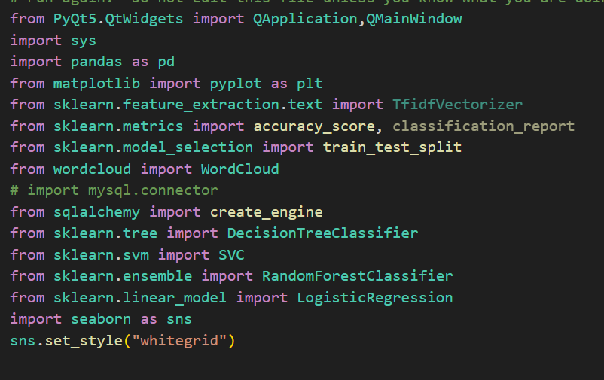
Importing necessary modules

Slide 10
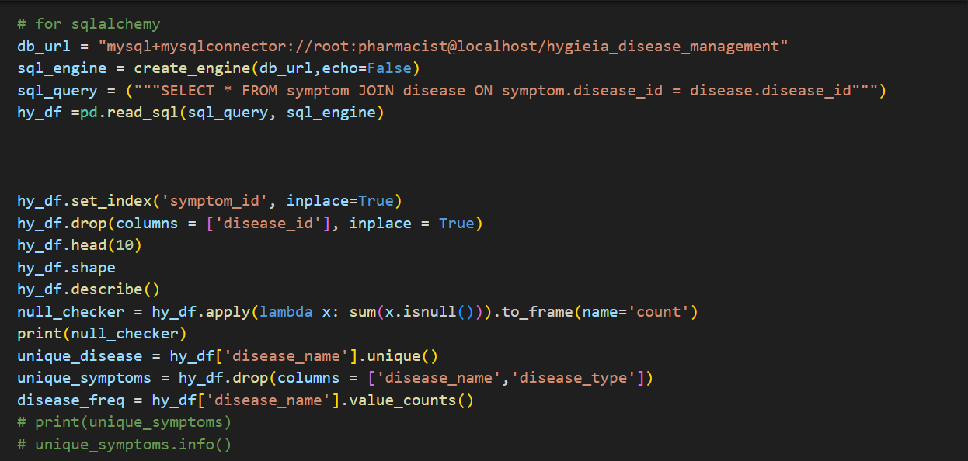
Exploration

Slide 11
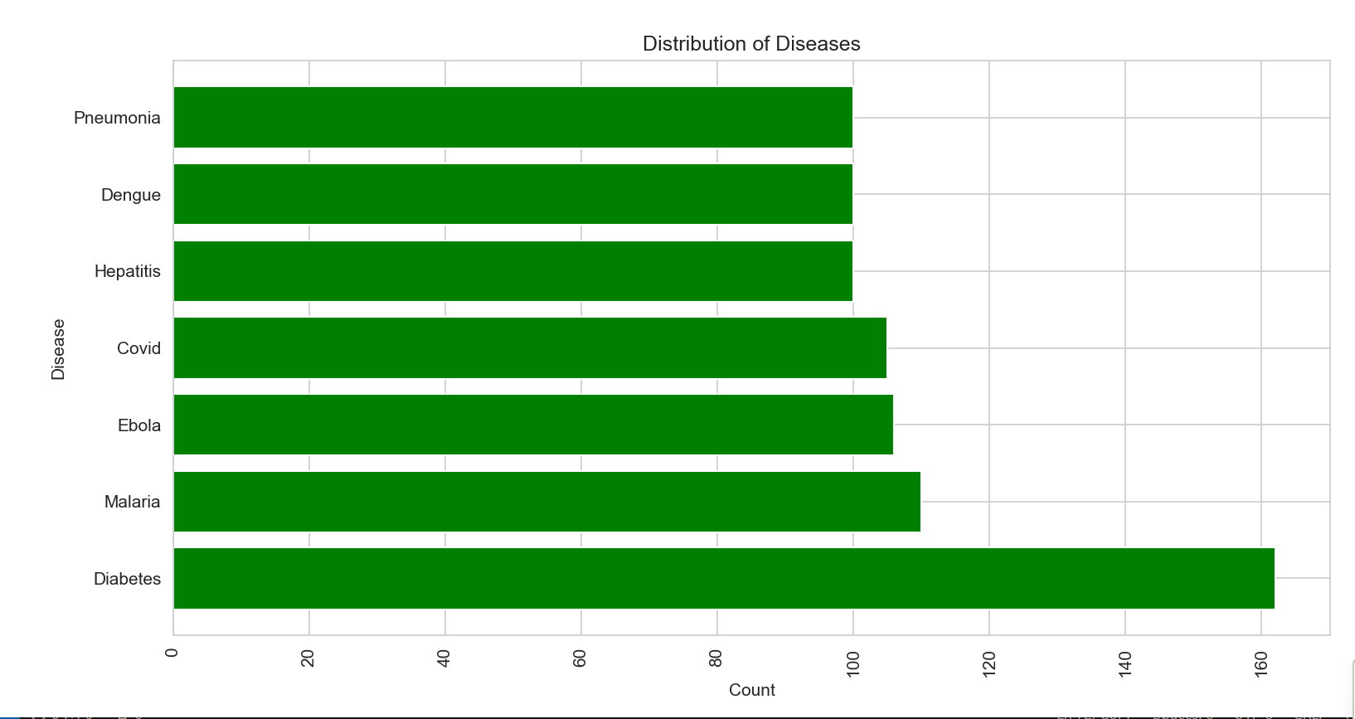
Distribution of disease against number of symptoms

Slide 12
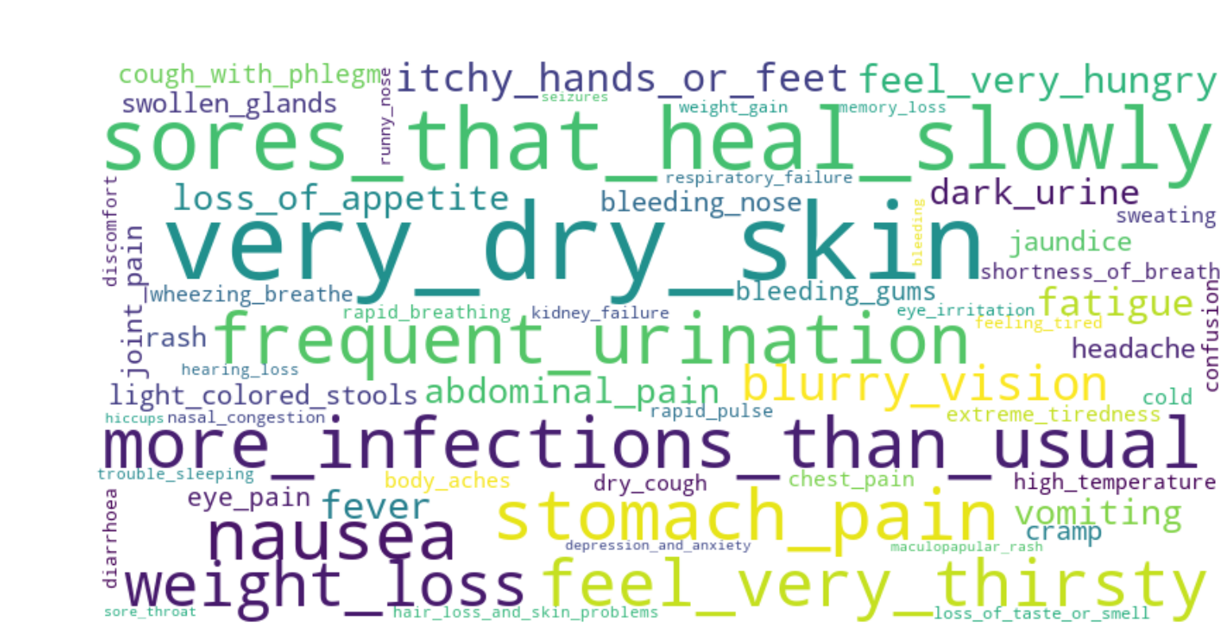
Exploration of symptoms using word cloud

Slide 13
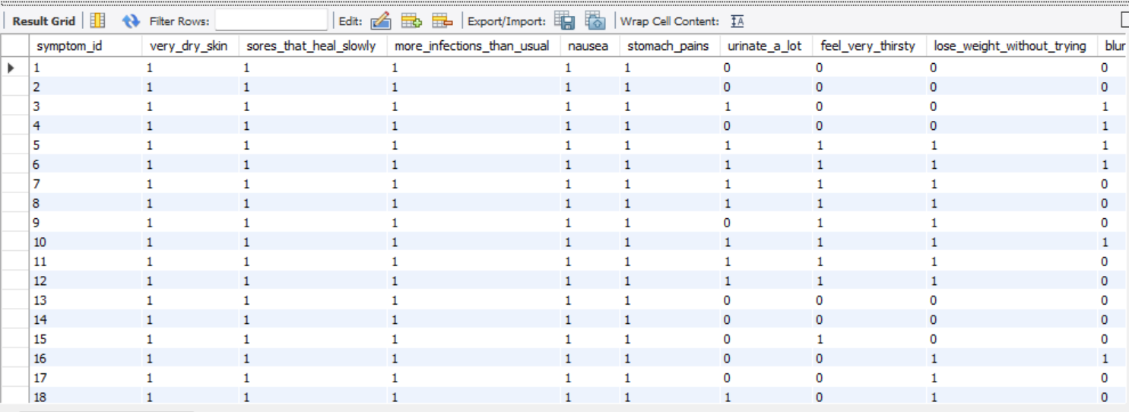
Hygieia Management Database
Hygieia Database with samples of symptoms collected against disease

Slide 14
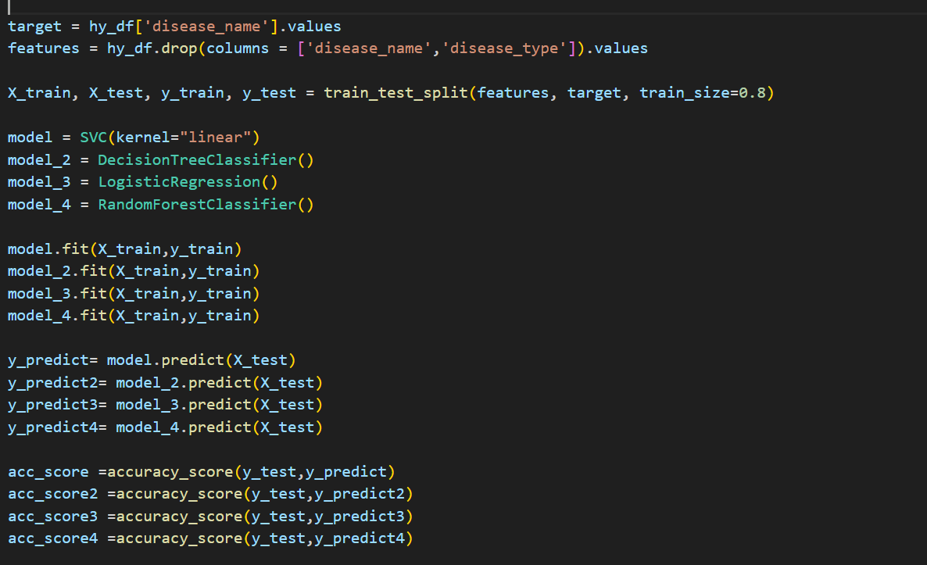
Training, splitting and fitting data

Slide 15
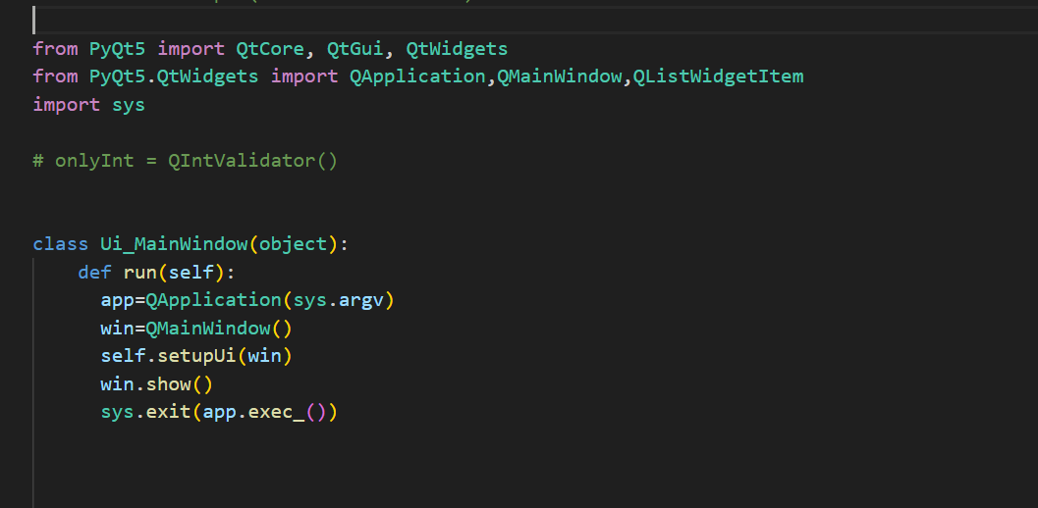
Importing GUI Modules from PyQt5

Slide 16
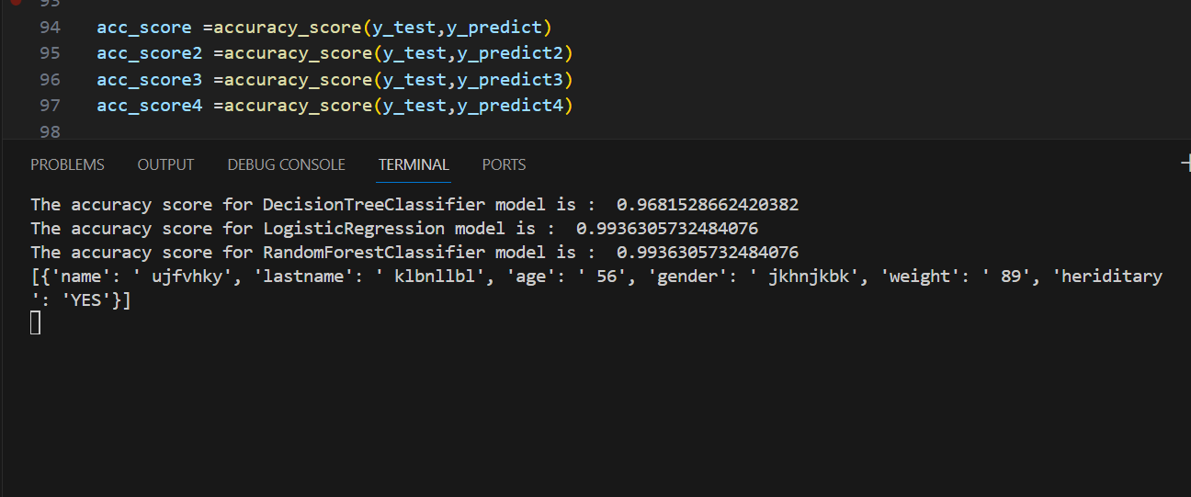
Accuracy Score for ML Models

Slide 17
How To Use
Patients input their details on the home page
Patients input their symptoms through a user-friendly interface.
Data collected includes symptoms.
Then the result for likelihood of each disease will be shown in the diagnosis page using the already trained prediction model

Slide 18
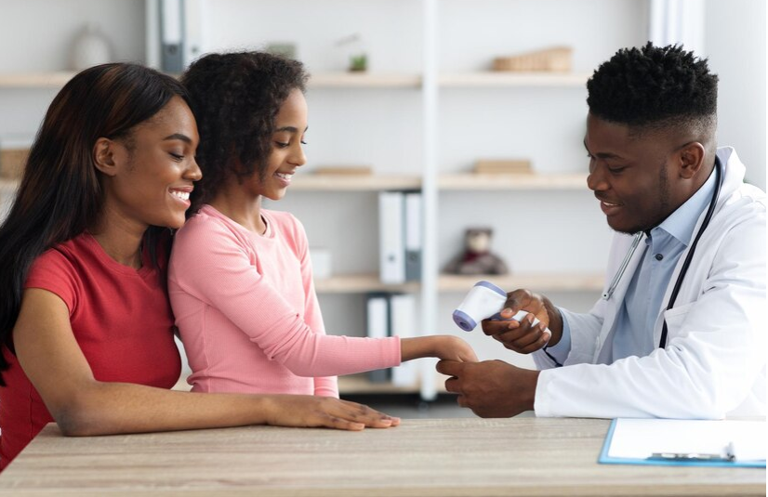
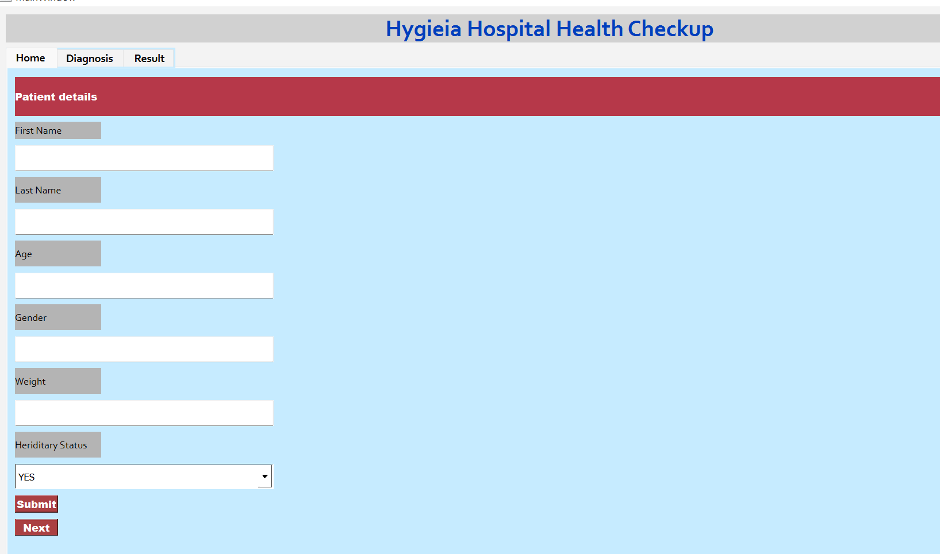

Slide 19
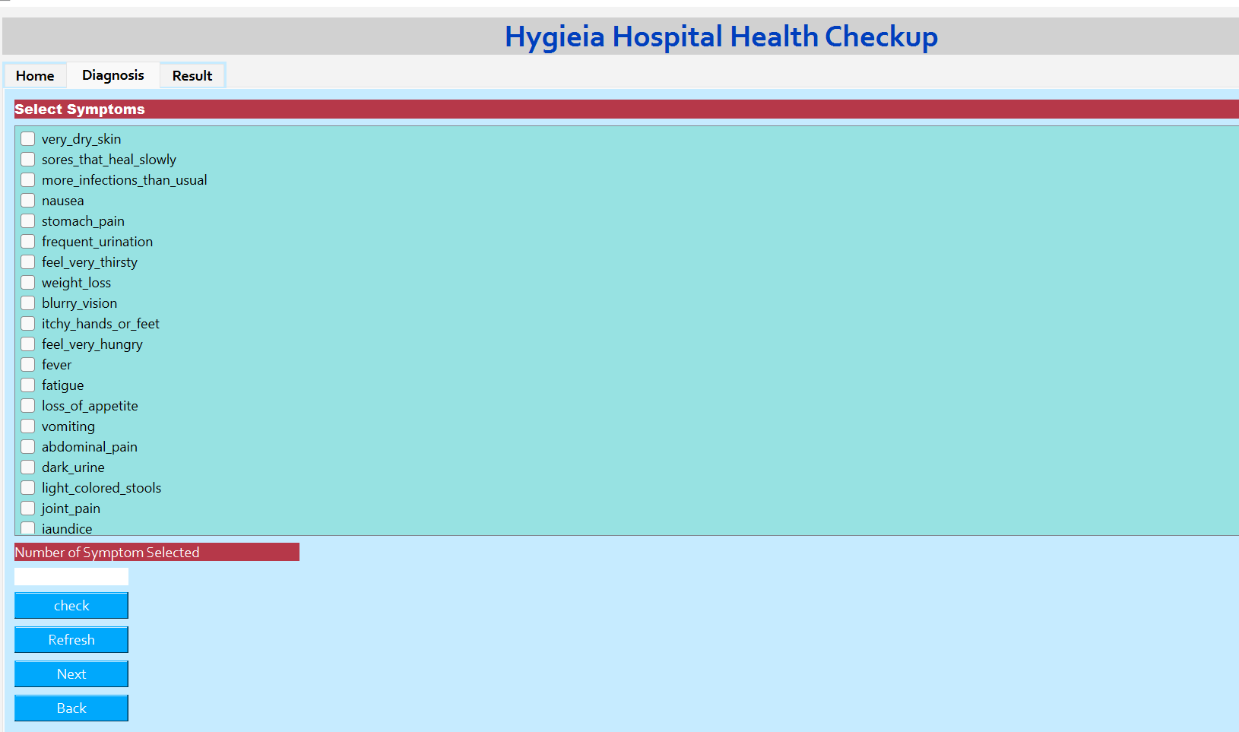

Slide 20
